Slide 1

Florida Atlantic University
ITN 2022-ITN-0109- MR Student Insurance Brokerage Services

Slide 2
About IFS & FH
Insurance For Students (IFS) has been marketing and managing student insurance products for over 40 years under the management of Pat White. Pat’s in-depth knowledge of the industry has helped clients with negotiations, insurance companies, development of products and analysis of benefit plans.
In January of 2021, IFS merged with FutureHealth (FH), a health education and mental health company, to develop the next generation of Student Health Insurance Products. FH founder, Kevin Saremi, has been in the Student Insurance market for over 30 years. He was the founder and CEO of Consolidated Health Plans (now Wellfleet). Kevin’s background includes PPO development, underwriting, claims processing and all administrative aspects of running an insurance company with clients and students in mind.

Slide 3
Meet the Team
Craig Bode – Vice President of IFS & Main Contact for Florida Atlantic University
Pat White – President and Founder of IFS
Kevin Saremi –President and Founder of FH
Fran Buit – Chief Operations Officer of IFS & Secondary Contact for Florida Atlantic University
Gina Warga – Marketing Manager of IFS
Rob Aquadro – Controller of IFS
James Zarvis - Development Manager of IFS
Paula Hamilton LICSW - Director of Account Services/Counseling

Slide 4
Agenda
Introduction
Waiver System
Health Education / Promotion
Mental Health Counseling Services / Case Management
Sample Reports
Partnering with FAU / Setting New Standards
Setting Expectations and Deliverables
Marketing the Program
Responses to Specific Questions
Value Proposition
Questions and Answers

Slide 5

Waiver System
An easy to use, mobile accessible, fully customizable smart waiver.

Slide 6

Students waive with seven simple steps
Waiver Certification – This certifies that the student knows what waiving is and wants to proceed with waiving.
Login/Registration – the student registers and/or logs in.
Waiver Eligibility – This certifies that the student understands the requirements to waive.
Personal information – This gathers student personal information for verification.
Insurance Information – This gathers specific existing insurance information and is fully customized to your waiver requirements.
File Upload – The student uploads supporting documents such as an insurance ID card.
Submission – The student submits the waiver and receives verification of submission.

Slide 7
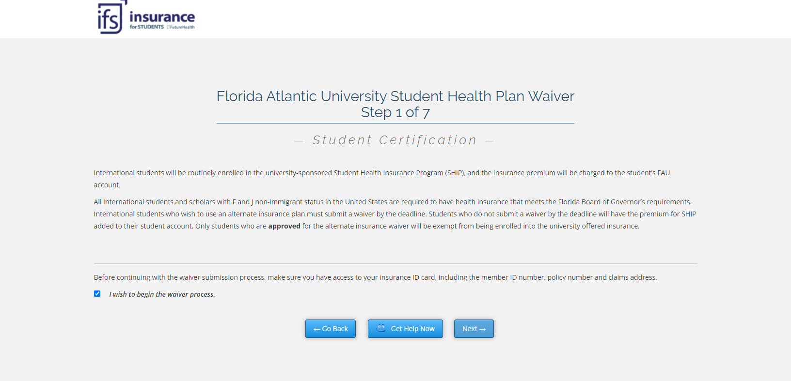

Slide 8
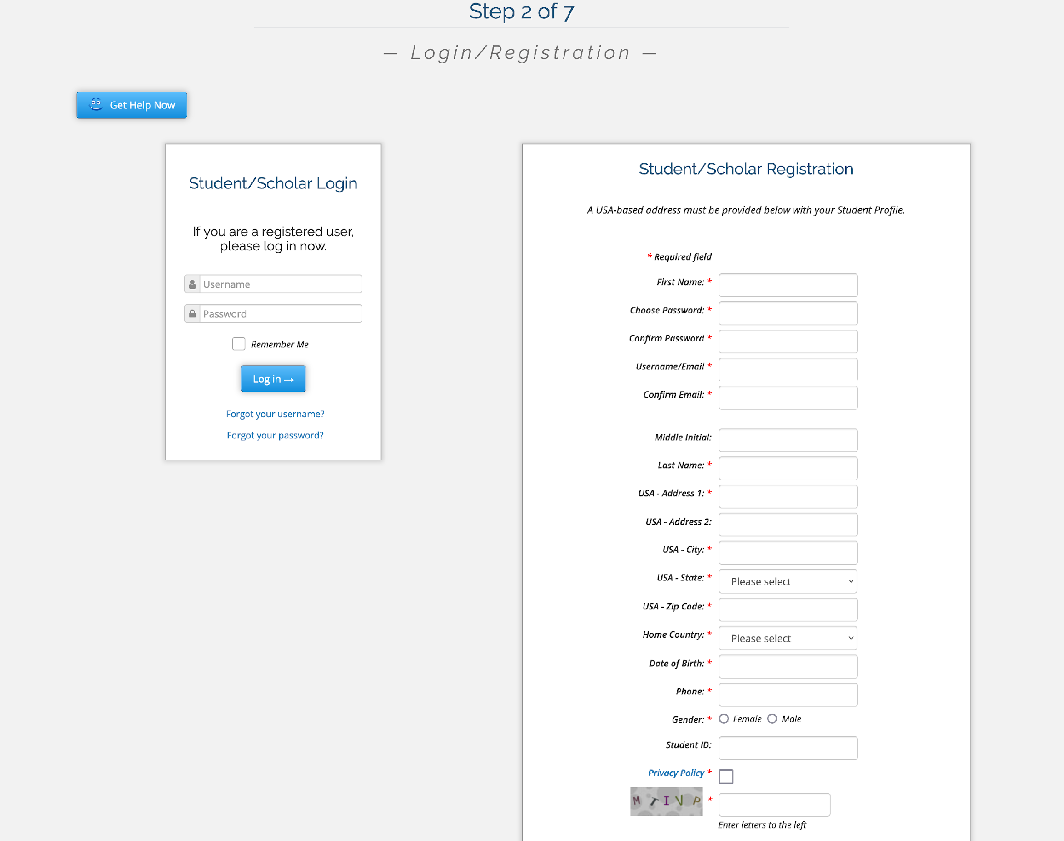
Login/Registration

Slide 9
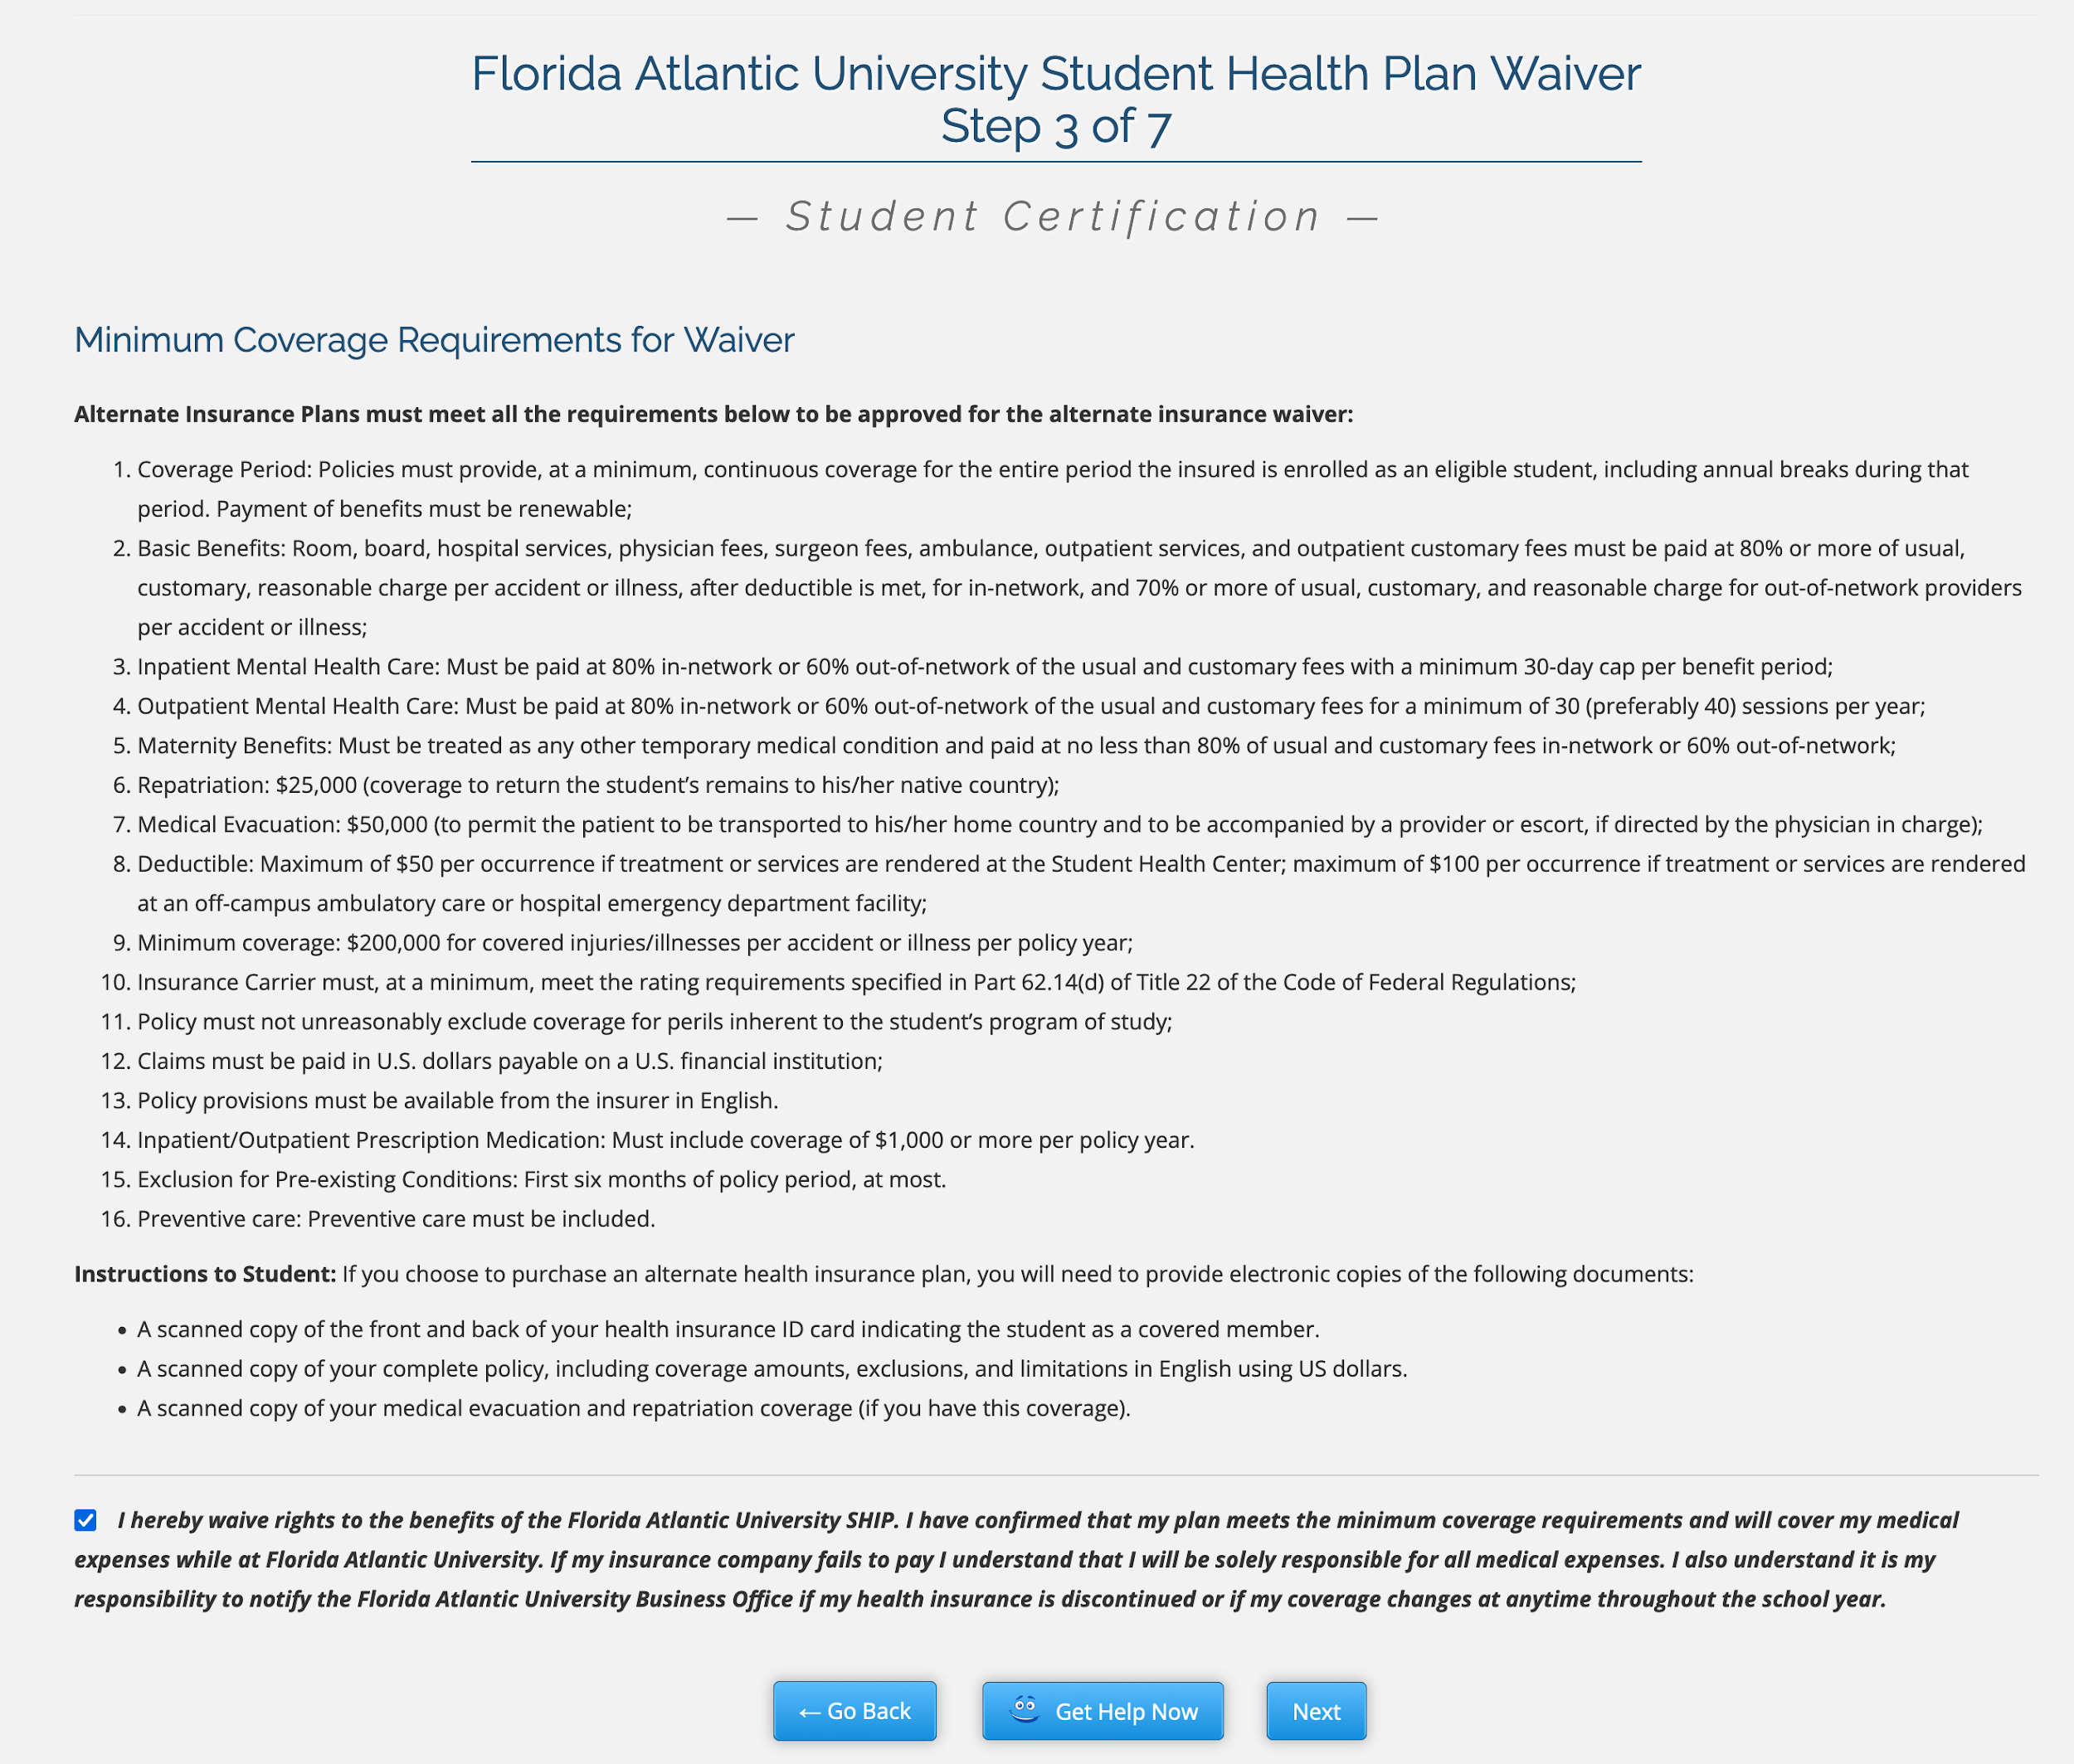
Waiver Eligibility
Correct Coverage Dates
Deductible Maximum
And more!

Slide 10
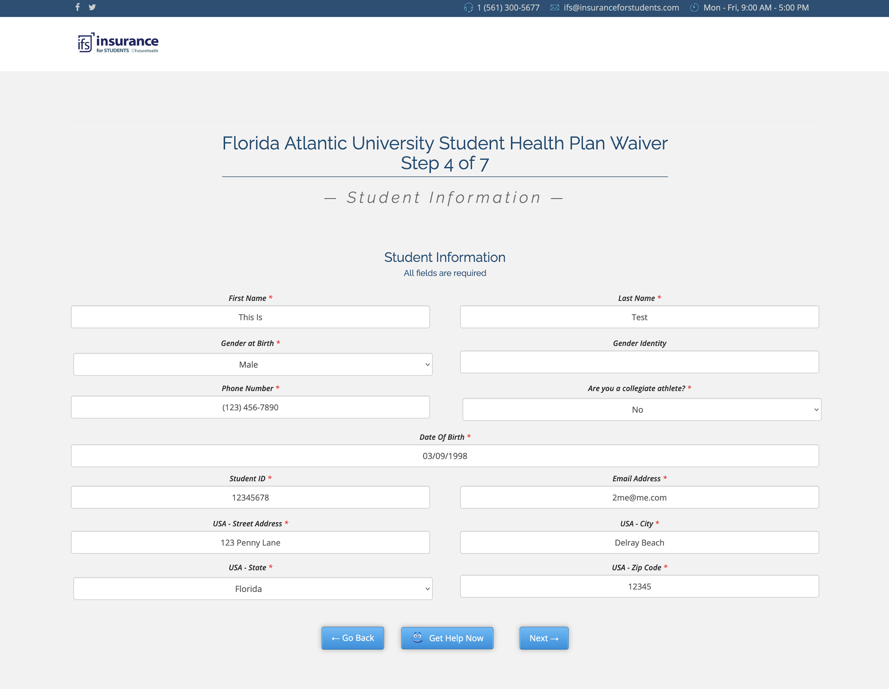
Personal Information

Slide 11
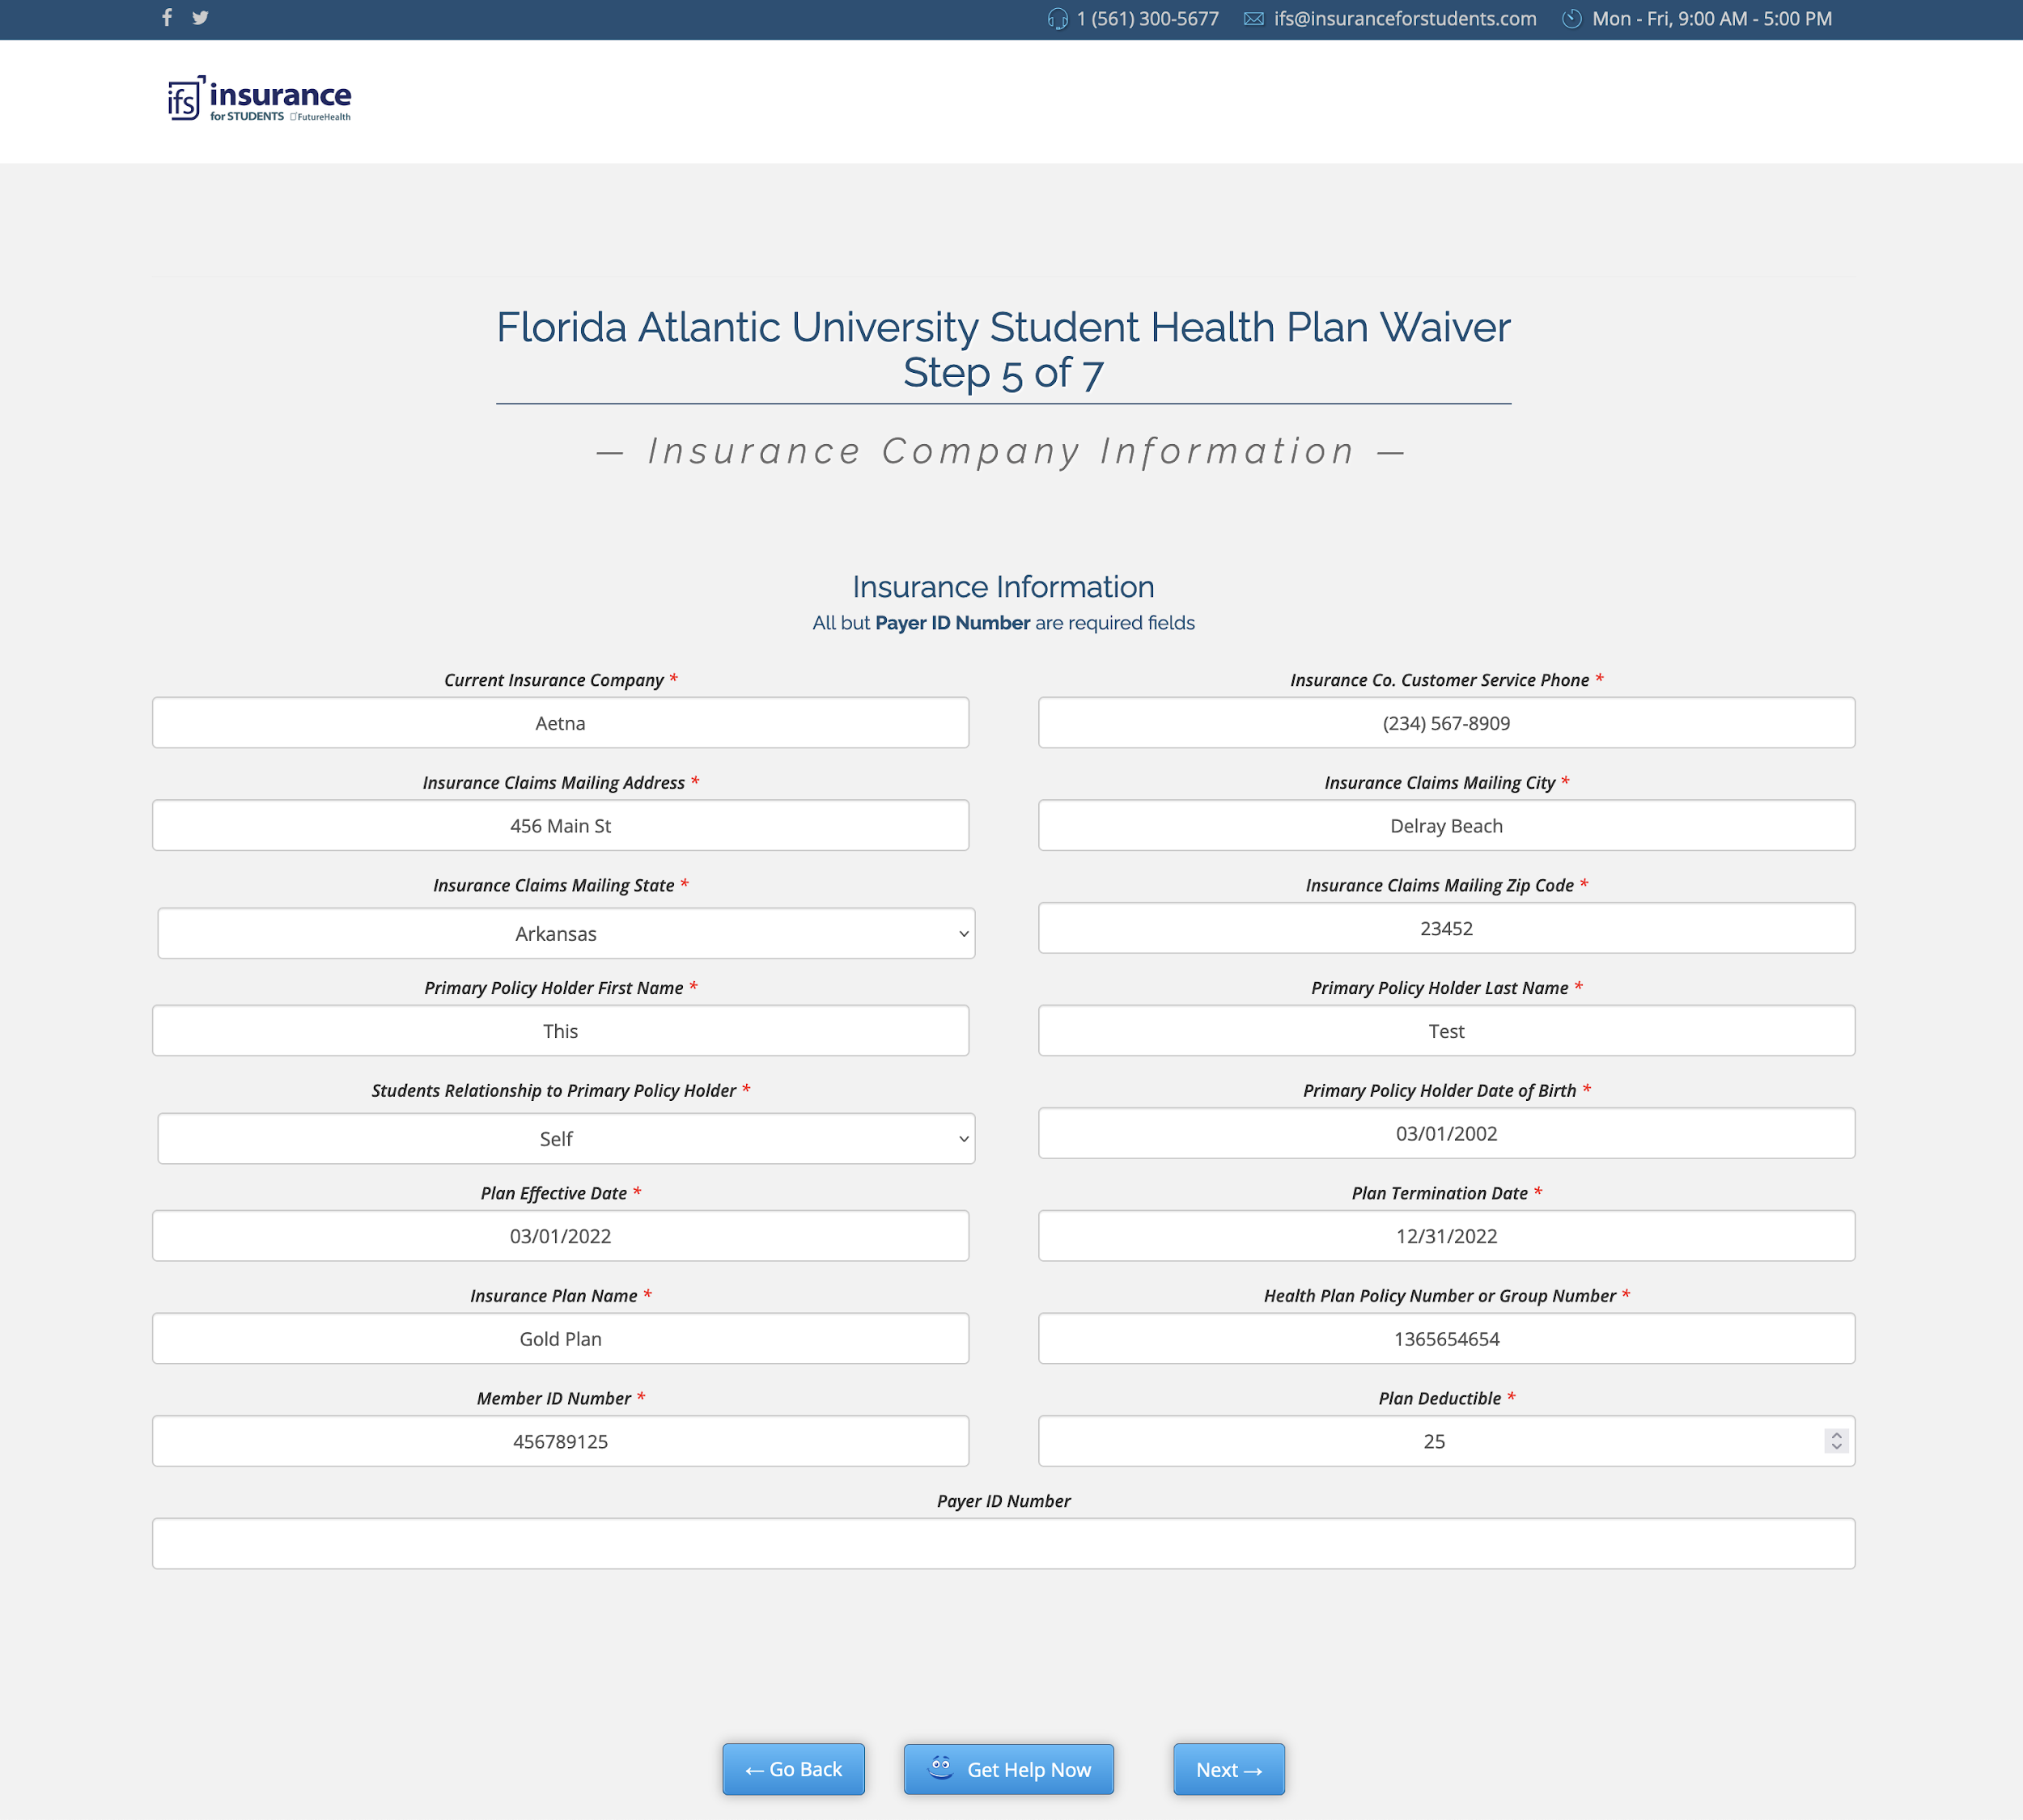
Insurance Information

Slide 12
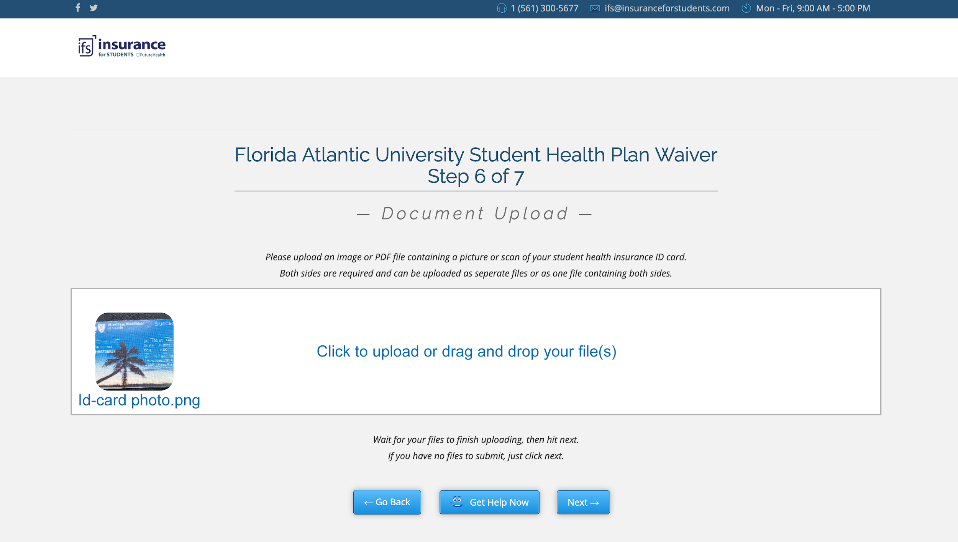
File Upload

Slide 13
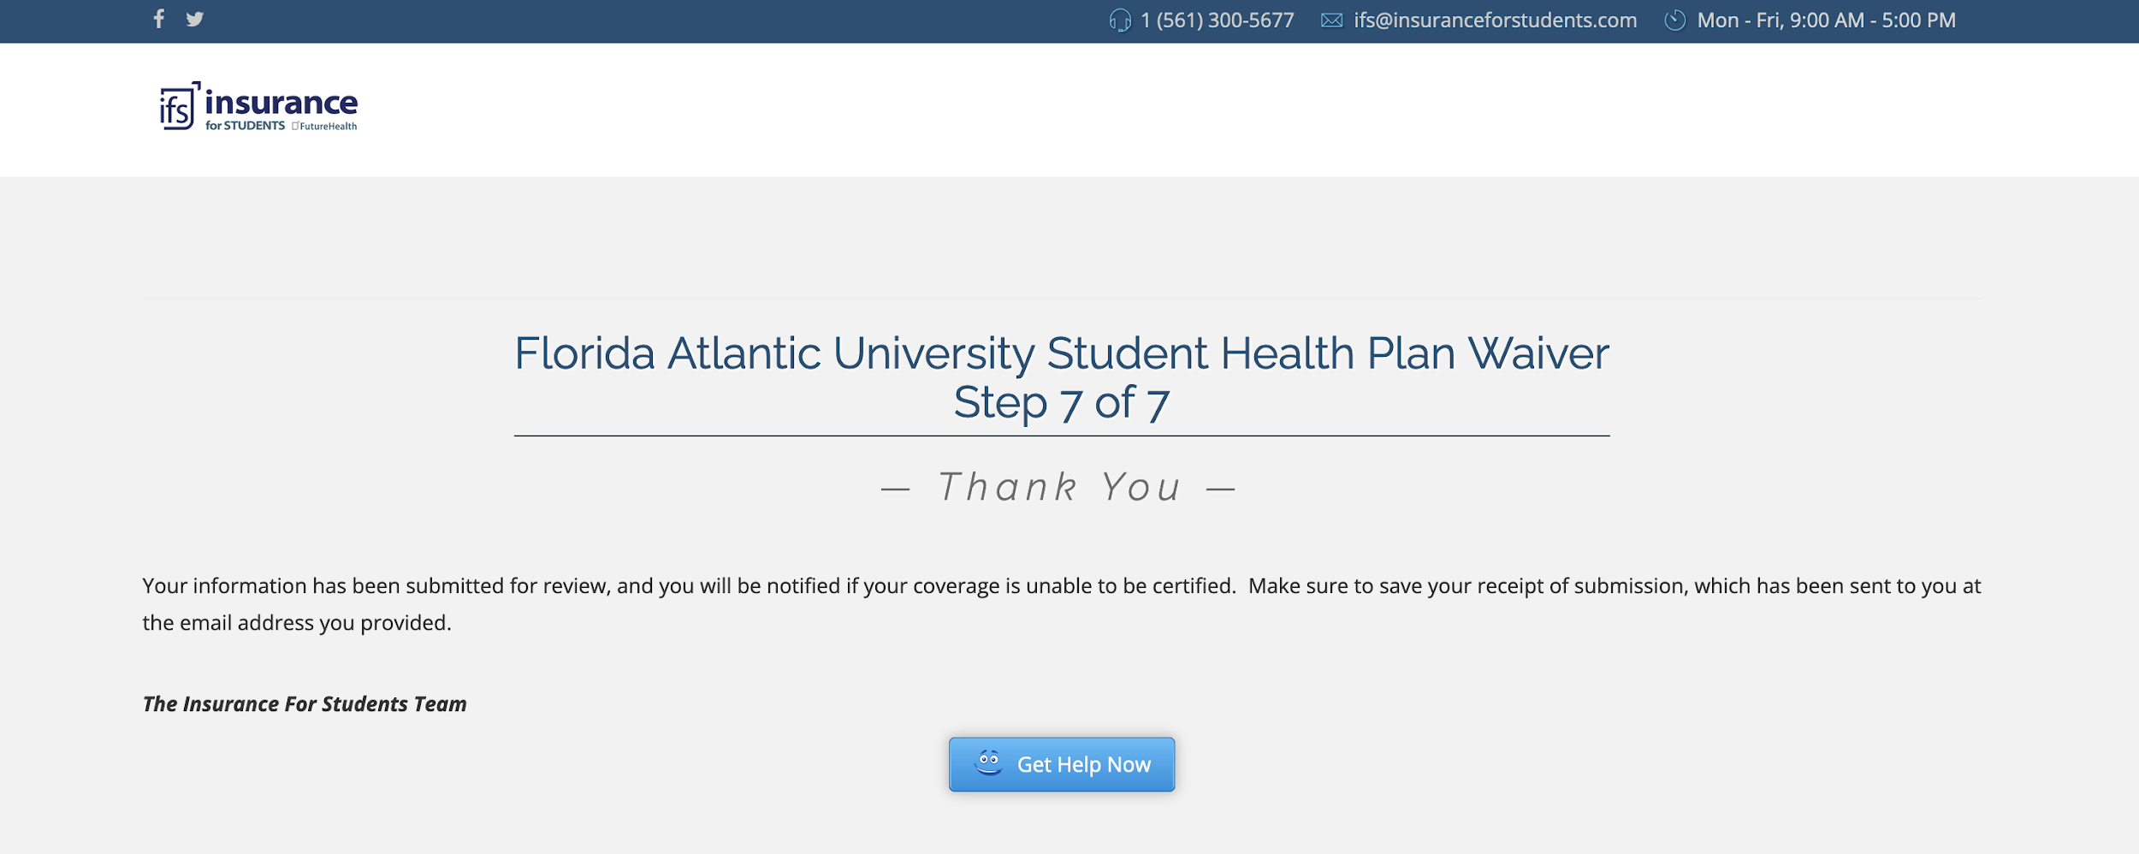
Submission

Slide 14

Help Videos
Close Captioning in:
English
French
Mandarin
Spanish
And More!

Slide 15

Smart Waiver System
Auto deny waivers that do not meet the criteria such as inappropriate carriers, high deductibles or non ACA compliant.
This reduces the amount of administration required.
The IFS team reviews the waivers daily with a management interface that allows them to quickly assess and approve or deny waivers with auto email generation and data handling.

Slide 16
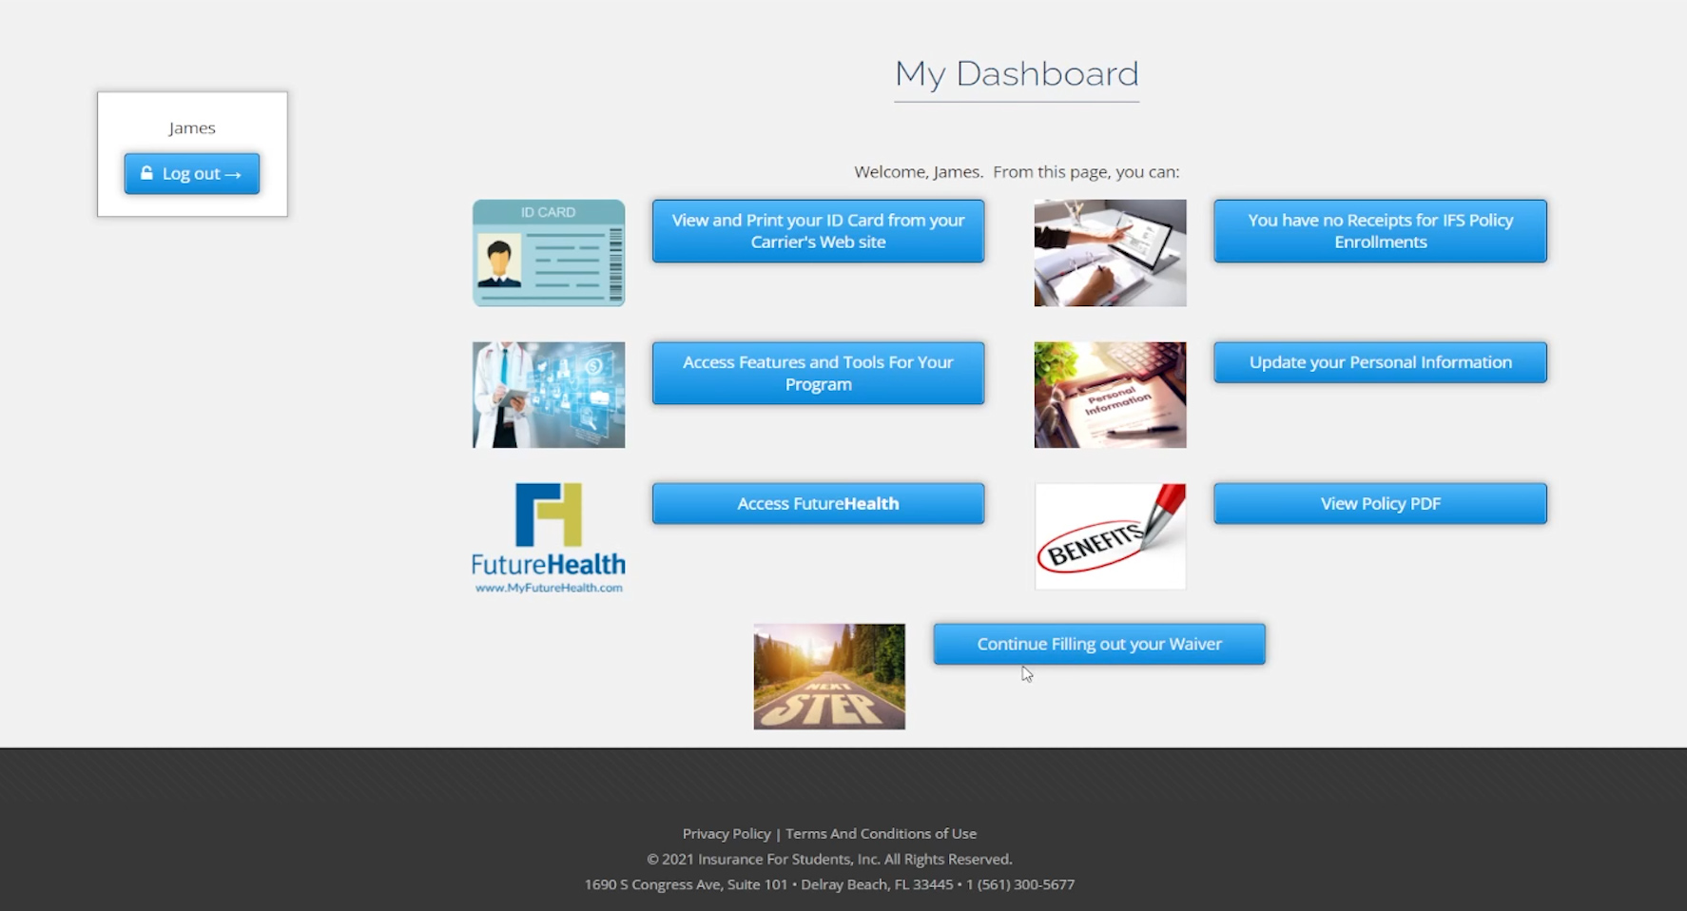
Students Waiver Status

Slide 17
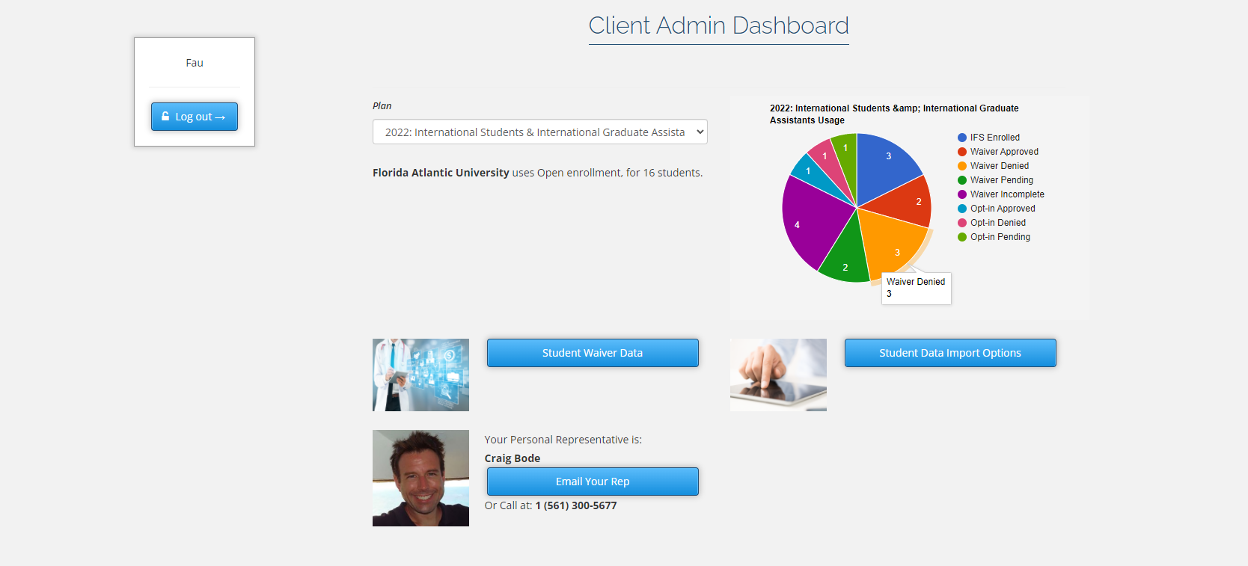
School Administrator Dashboard

Slide 18
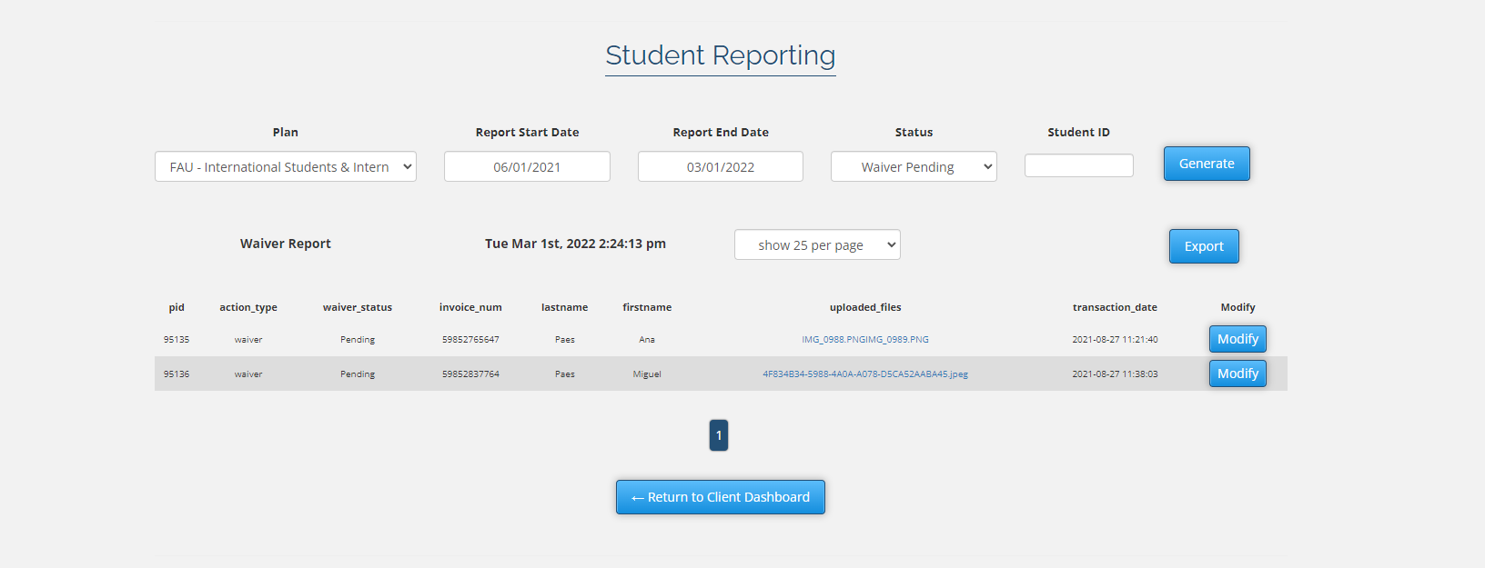
School Administrator Detailed Data

Slide 19

Waiver Customizability
Works with Open or Closed Lists
Total control of the waiver including when and how it can be accessed
Regular check-ins with your representative

Slide 20

Waivers that work for you
Total live access to your waiver data
Completely customizable
Easy to use and manage

Slide 21



Our Holistic Approach
A Student Assistance Program (ASAP) has three components:
FutureHealth’s online Health & Wellness program
3. 24/7/365 Counseling Hotline for support
2. Student Outreach

Slide 22

Health Education
FutureHealth’s Online Health & Wellness Education Program
This comprehensive education program includes topics such as:
Alcohol use disorder
Opioid use disorder
Sexual misconduct
Sleep deprivation
Anxiety and stress
Depression
Eating disorders
Diabetes
Personal safety
This program also offers the following enhancements:
Buddy chat forum
Additional Resources
Blogs and health events
Healthy recipes
Hiking trail locator
Health trivia
Program incentives
Assessments and goals
And more!

Slide 23




Student Outreach Program
Multi-faceted Communications
Inspirational texts
Daily emails
Health Promotion
Posters, brochures, cards, etc.
Encourages students to use campus resources
Customized Videos
For campus events
Virtual Events
Free webinars

Slide 24


Paula Hamilton, LICSW
Director of Account Services and Business Development
Coastline EAP
A Student Assistance Program (ASAP)
Coastline has partnered with FutureHealth to provide college students easy access to counselors who understand student life. Consultation is available 24/7 by phone for emotional support, assessment, crisis intervention and referrals to local therapists, telehealth and other reliable resources

Slide 25

Features of Coastline’s Student Assistance Program
Immediate support 24/7 by phone 1-833-445-5058
Immediate translation service supporting 250+ languages
Cultural sensitivity in program delivery
Access to Masters level counselors
Ongoing telephonic and videoconference support
Carefully matched counseling referrals
Up to 3 face to face sessions with a professional counselor in the student’s insurance network for ongoing care
Consultation, resources and referrals for daily living needs such as community resources, financial counseling, legal services, and child and eldercare
Self-directed online resources including webinars, videos, courses, wellness tools and more
Live Wellness sessions delivered by videoconference on topics including mindfulness, breathing, meditation, chair yoga and journaling
Coastline maintains strict adherence to state and federal confidentiality laws

Slide 26
Setting Expectations & Deliverables
Partnering with FAU
Phase 1
*Please note the above dates are suggested dates.
FAU | Awards the Contract | March 8th
IFS/FAU | Assemble Team | March 10th
IFS/FAU | Review Current Plan and Possible Changes Discuss Current Internal Processes Reviewing Current Servicing Issues | March 10th – 18th
IFS | Develop Waiver Specs & Complete the Process | March 10th – 28th
IFS/FAU | Development of Enrollment Interface & Accounting Processes | March 18th – 28th
IFS | Finalize Benefit Plan and Rates | March 18th – 28th
IFS | Development of Marketing Campaign | March 28th – April 8th
FAU | Approval of Marketing Material | April 3rd
IFS | Waiver Process and Setup Complete | April 3rd
 | Phase one complete | April 8th

Slide 27
Setting Expectations & Deliverables
Phase 2
*Please note the above dates are suggested dates.
IFS | Install Yealink | May
IFS | Training of Staff on Admin System | May
IFS | Develop Customized Health Promotion Material | June
IFS | Training of Staff on FH/Counseling | June

Slide 28
Marketing The Program
Insurance for Students is able to develop marketing materials to promote the student health insurance plans through brochures, email blast and social media.

Slide 29
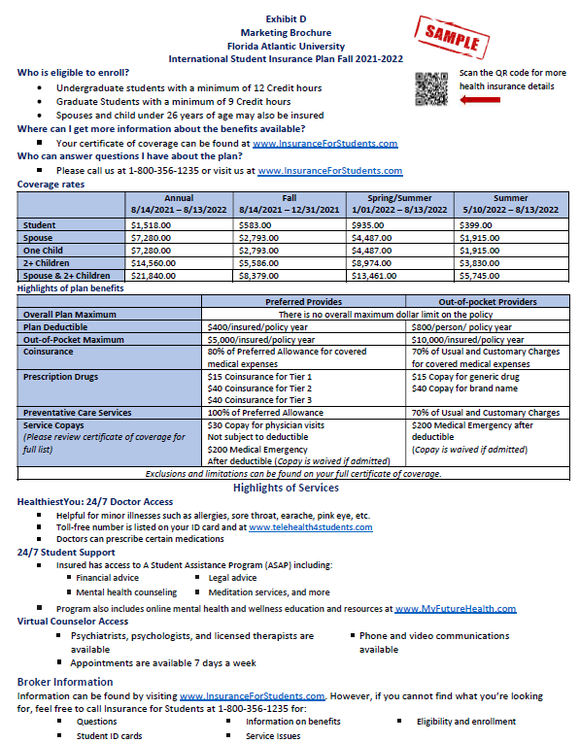

Slide 30



Marketing Emails

Slide 31




Slide 32
Sample Reports
Sample 1 - ASAP Utilization Report
Sample 2 – Loss Ratio Report

Slide 33
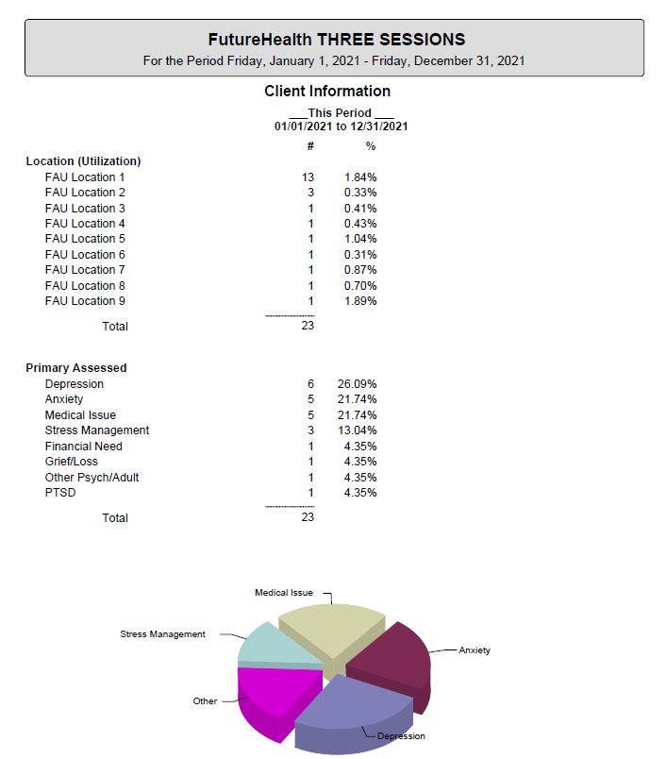

Slide 34
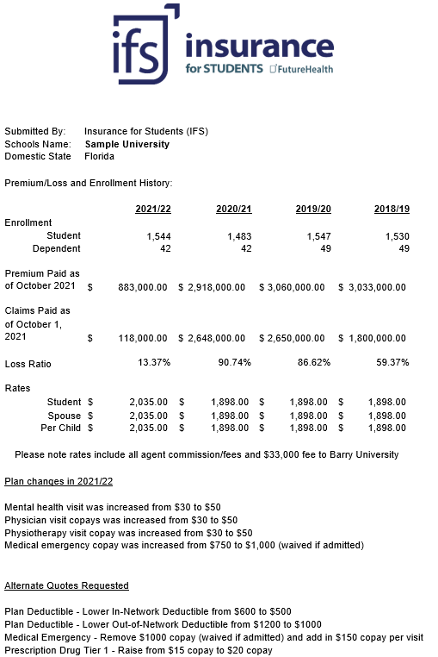

Slide 35
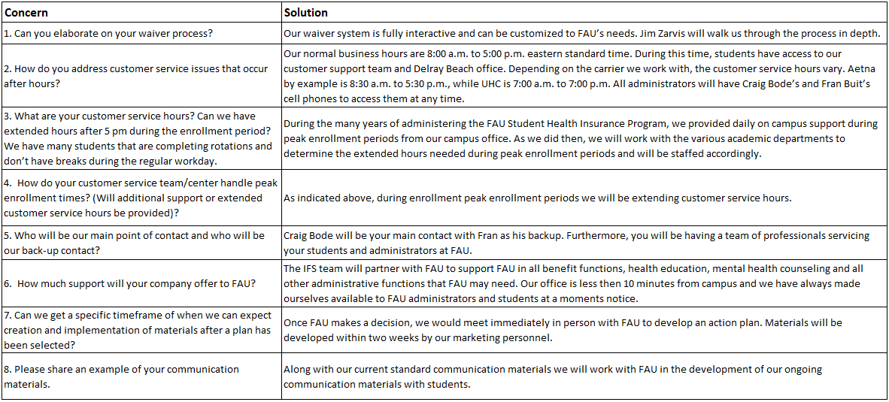
Responses to Questions

Slide 36
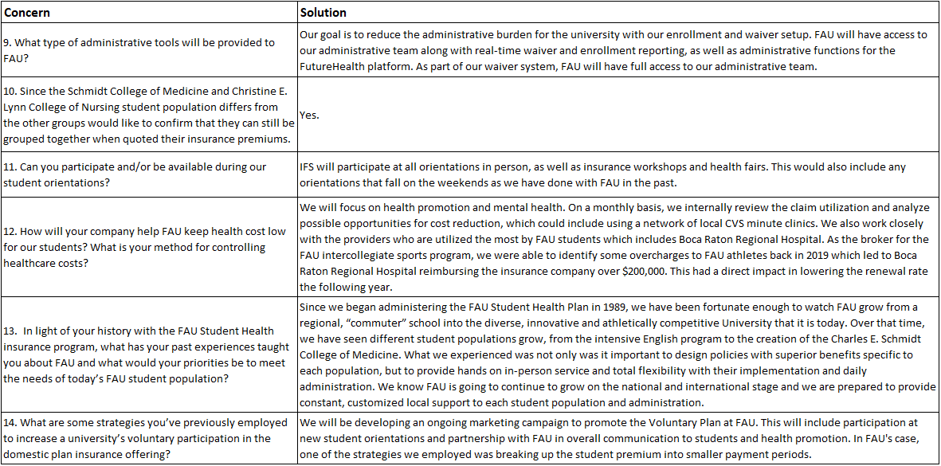

Slide 37
The IFS Value Proposition
Why IFS
We bring in over 40 years of experience in the Student Insurance Market.
We review and underwrite your plan independently before we negotiate the renewal rates with the carriers. We will meet with you quarterly and monitor the plan performance.
Through ongoing review of your utilization reports, we will identify areas for potential savings, including miscoding by providers and PPO discount.
We will provide ongoing health promotion and mental health services to your students.
Your administrative issues will be reduced by using IFS’s interactive waiver system, customized to your needs. You will have direct access to our team of professionals as if they were part of FAU.
Local office presence and long-standing participation within the FAU community
A direct line through Yealink will be installed to bring the next level of customer service, in addition to our 1-800 number.
IFS will participate in all your events on campus at your request.
IFS will work in partnership with you to enhance your student insurance services on an ongoing basis.

Slide 38

Question & Answers
Florida Atlantic University
&
A Partnership for Success

