Slide 1


Insurance Broker/Insurance Program Administrator Services for Student Health Insurance Plans and Intercollegiate Sports Plan RFP NS22-140

Slide 2
Meet the IFS Team
Michael Hmurcik – Vice President of Sales / Account Management
Michael Craney – Vice President of Sales / Account Management
Fran Buit – Chief Operations Officer of IFS
Gina Warga – Marketing Manager of IFS
James Zarvis - Development Manager of IFS
Pat White – President and Founder of IFS
Kevin Saremi –President and Founder of FH

Slide 3
About IFS & FH
Insurance For Students (IFS) has been marketing and managing student insurance products for over 40 years under the management of Pat White. Pat’s in-depth knowledge of the industry has helped clients with negotiations, insurance companies, development of products and analysis of benefit plans.
In January of 2021, IFS merged with FutureHealth (FH), a health education and mental health company, to develop the next generation of Student Health Insurance Products. FH founder, Kevin Saremi, has been in the Student Insurance market for over 30 years. He was the founder and CEO of Consolidated Health Plans (now Wellfleet). Kevin’s background includes PPO development, underwriting, claims processing and all administrative aspects of running an insurance company with clients and students in mind.

Slide 4
Agenda
Waiver System Overview
Mental Health Services / Health Promotion - Our Holistic Approach
Marketing
  Video Production
Student Health Insurance & Athletic Insurance Programs
Program Structure
In Summary
Q&A's

Slide 5
Waiver System
An easy to use, mobile accessible, fully customizable smart waiver.

Slide 6

Students waive with seven simple steps
Waiver Certification – This certifies that the student knows what waiving is and wants to proceed with waiving.
Login/Registration – the student registers and/or logs in.
Waiver Eligibility – This certifies that the student understands the requirements to waive.
Personal information – This gathers student personal information for verification.
Insurance Information – This gathers specific existing insurance information and is fully customized to your waiver requirements.
File Upload – The student uploads supporting documents such as an insurance ID card.
Submission – The student submits the waiver and receives verification of submission.

Slide 7
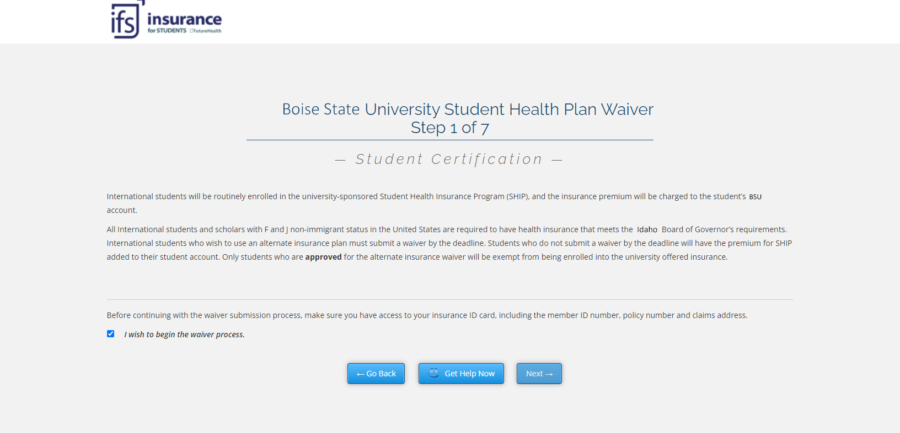

Slide 8
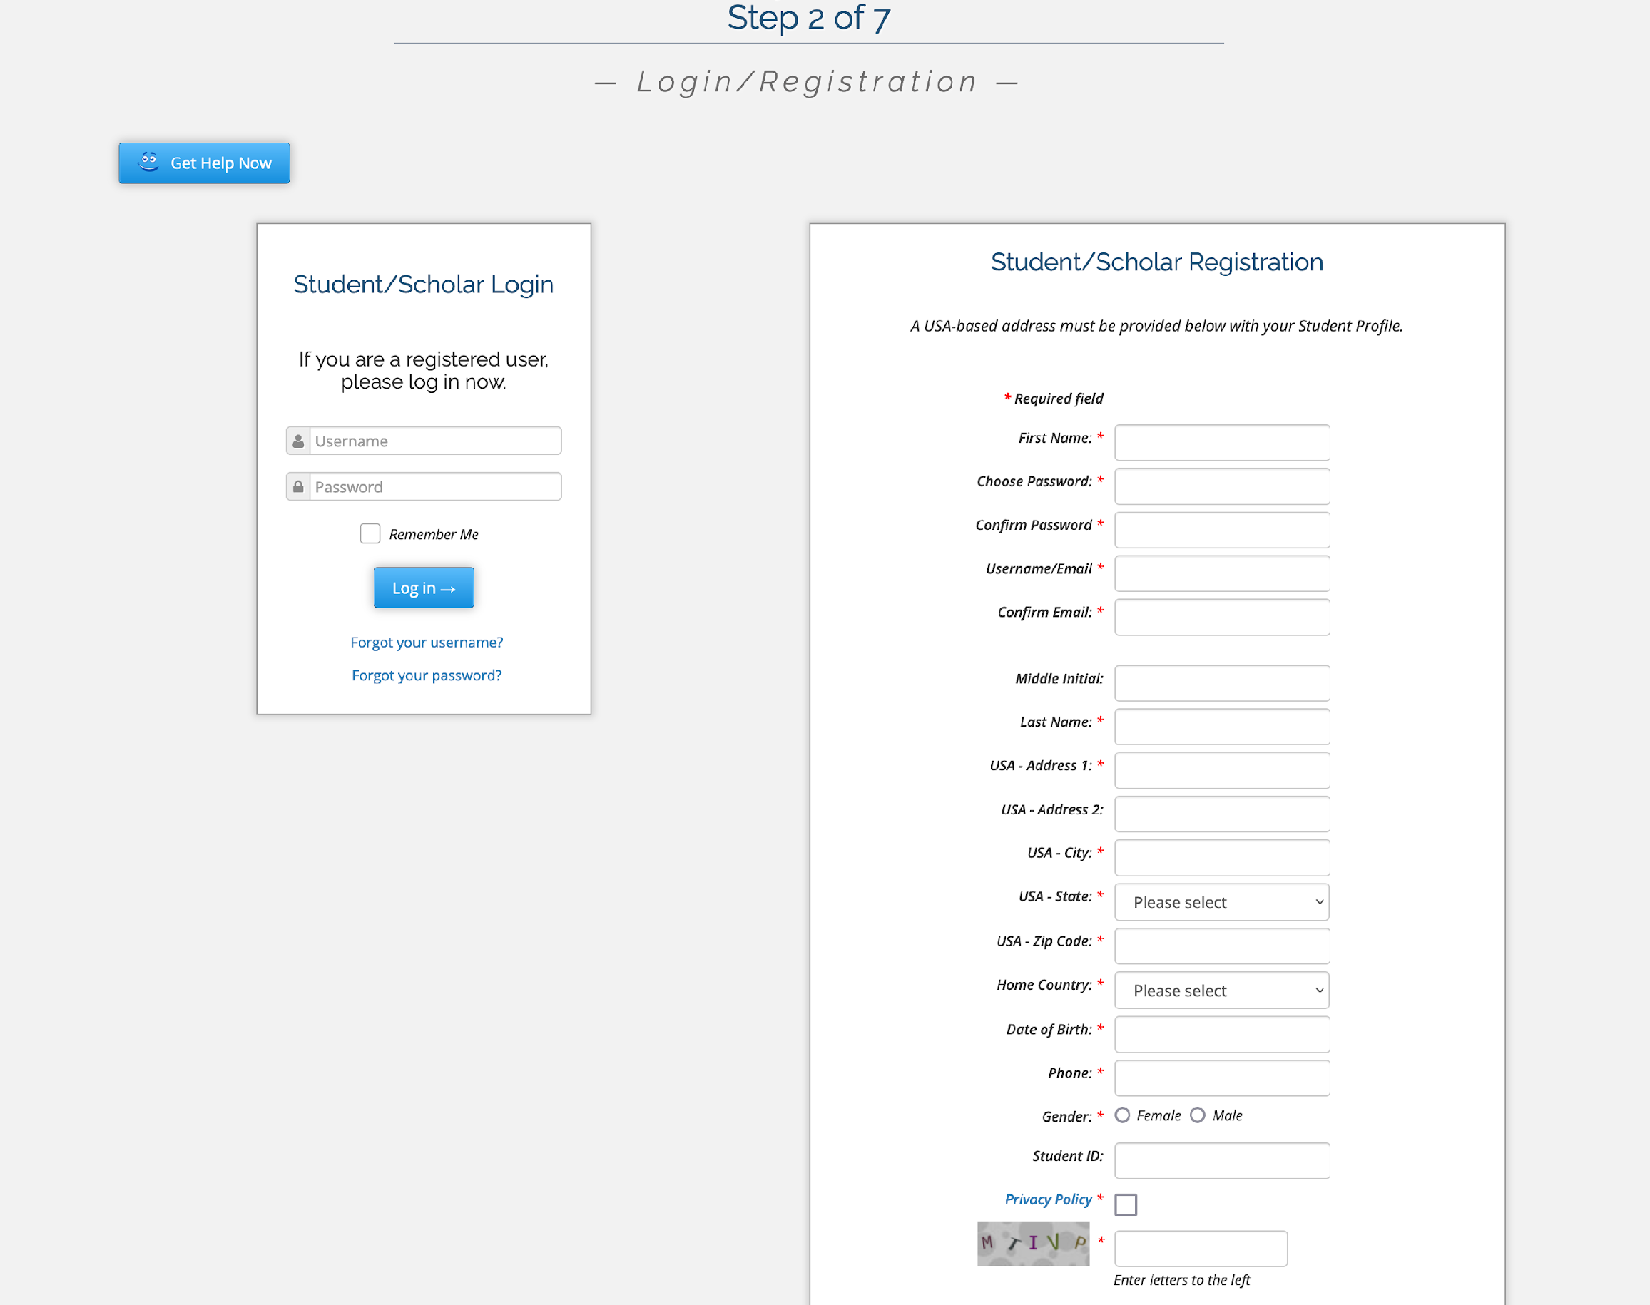

Login/Registration

Slide 9
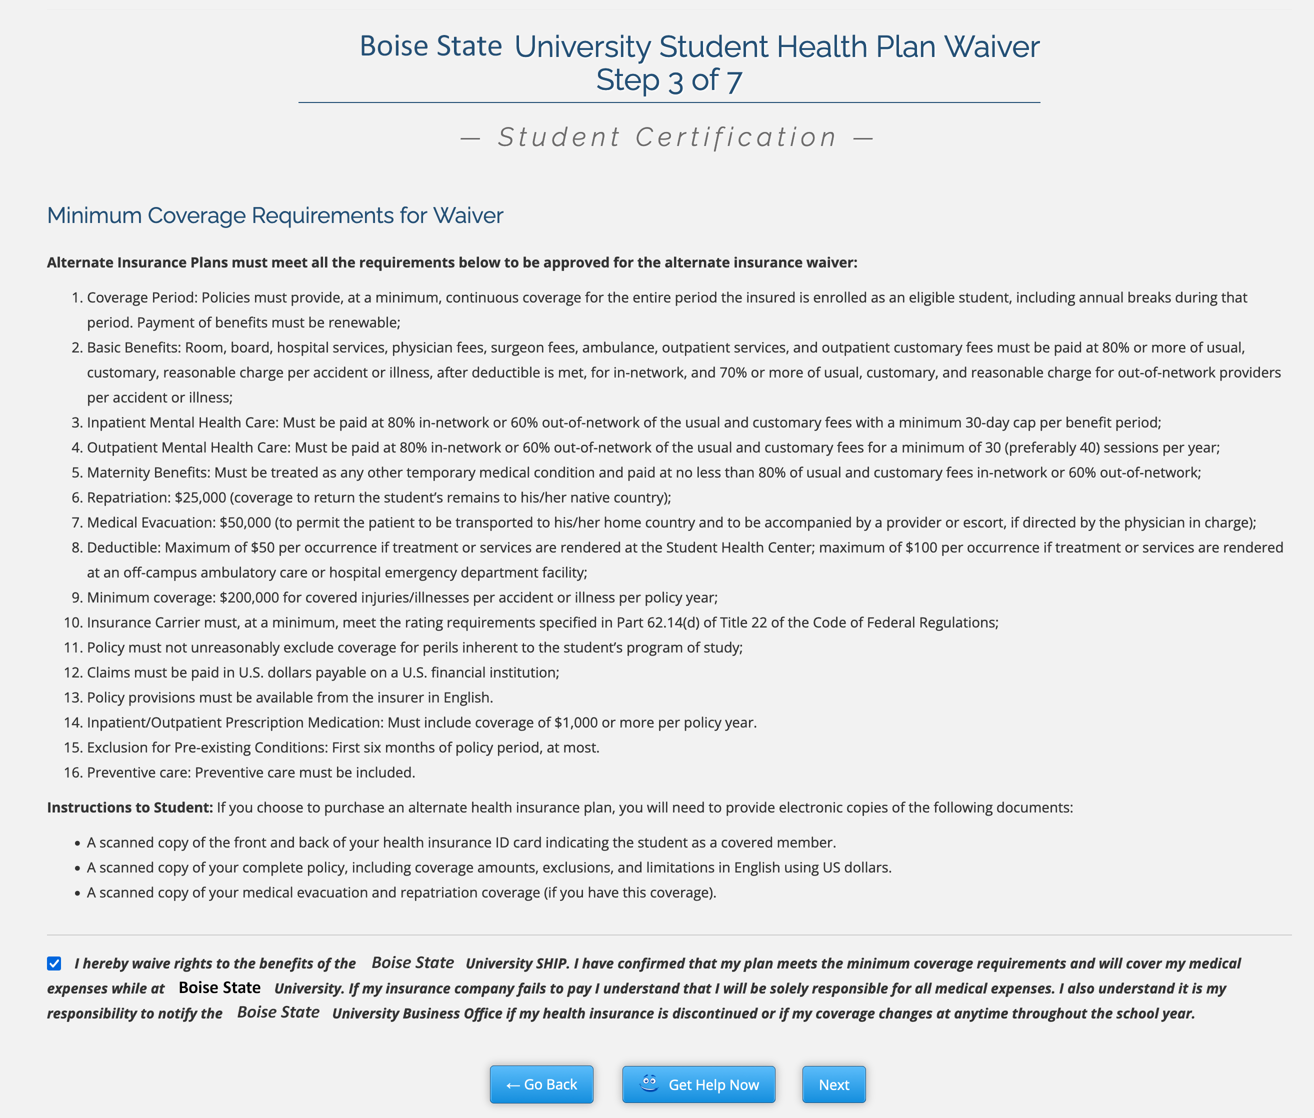

Waiver Eligibility
Correct Coverage Dates
Deductible Maximum
And more!

Slide 10
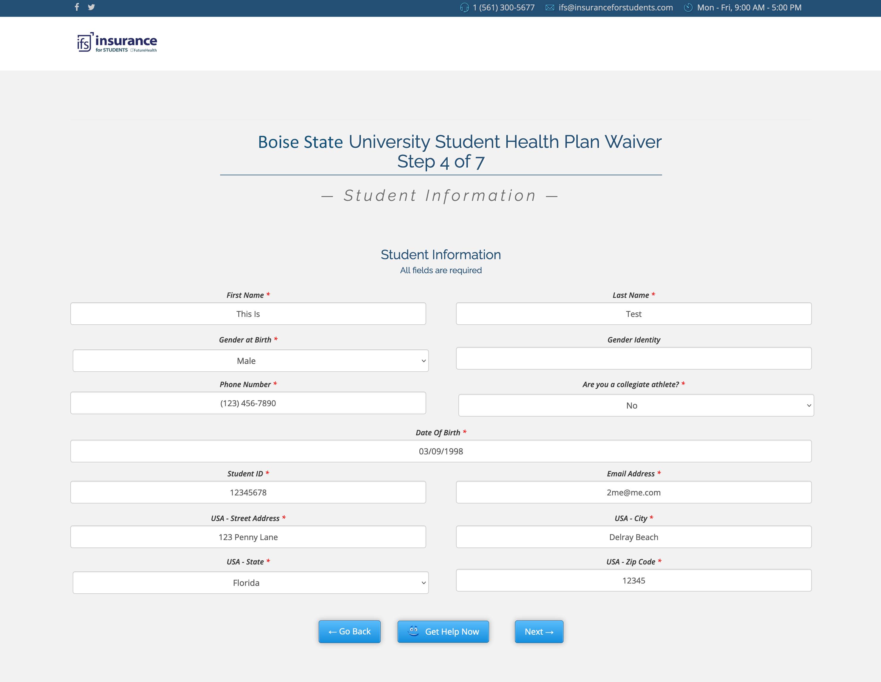
Personal Information

Slide 11
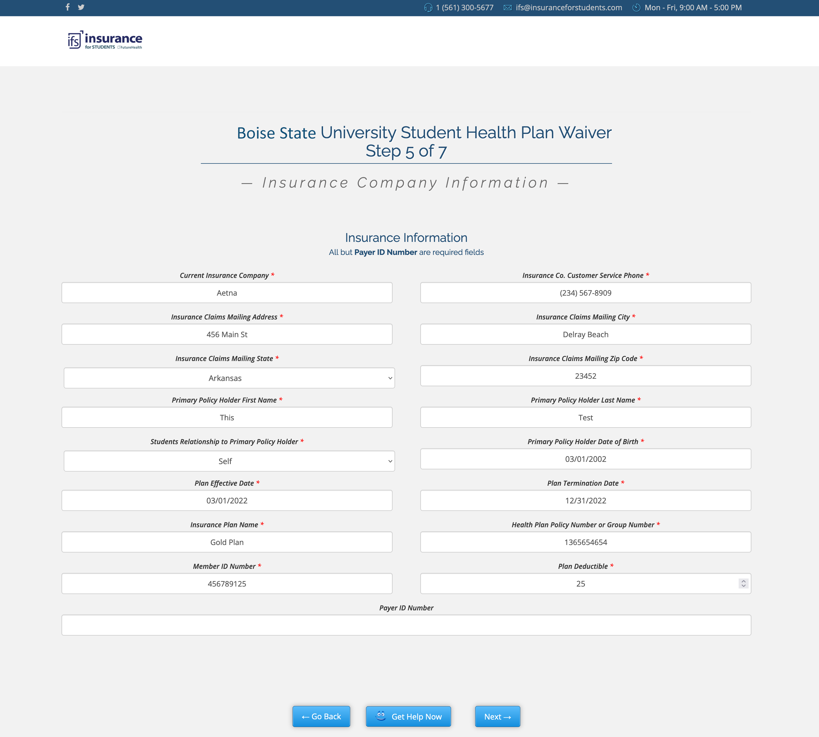
Insurance Information

Slide 12
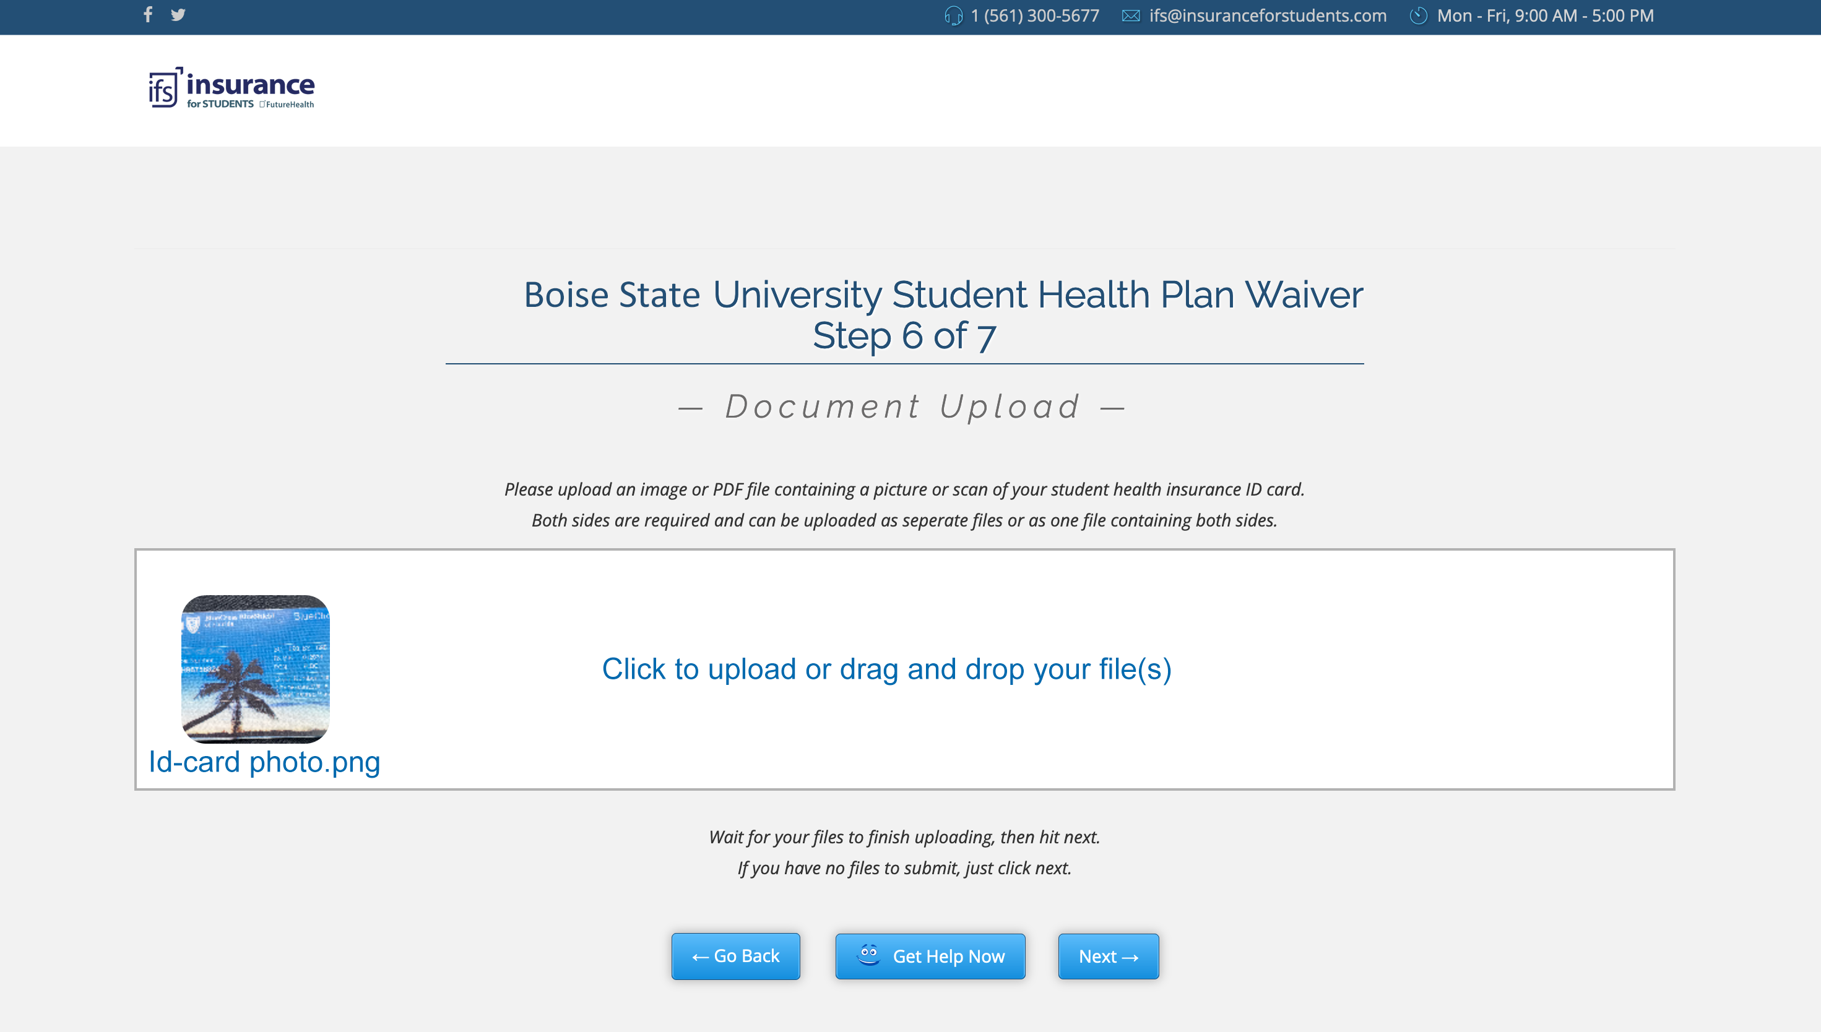
File Upload

Slide 13
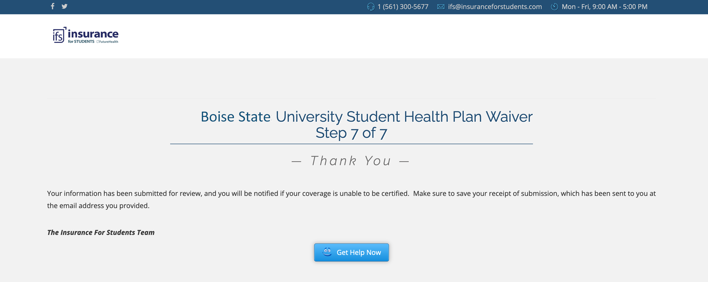
Submission

Slide 14

Help Videos
Sample Video
Close Captioning in:
English
French
Mandarin
Spanish
And More!

Slide 15

Smart Waiver System
Automatically denies waivers that do not meet the criteria such as inappropriate carriers, high deductibles or non ACA compliant.
This reduces the amount of administration required.
The IFS team reviews the waivers daily with a management interface that allows them to quickly assess and approve or deny waivers with auto email generation and data handling.

Slide 16
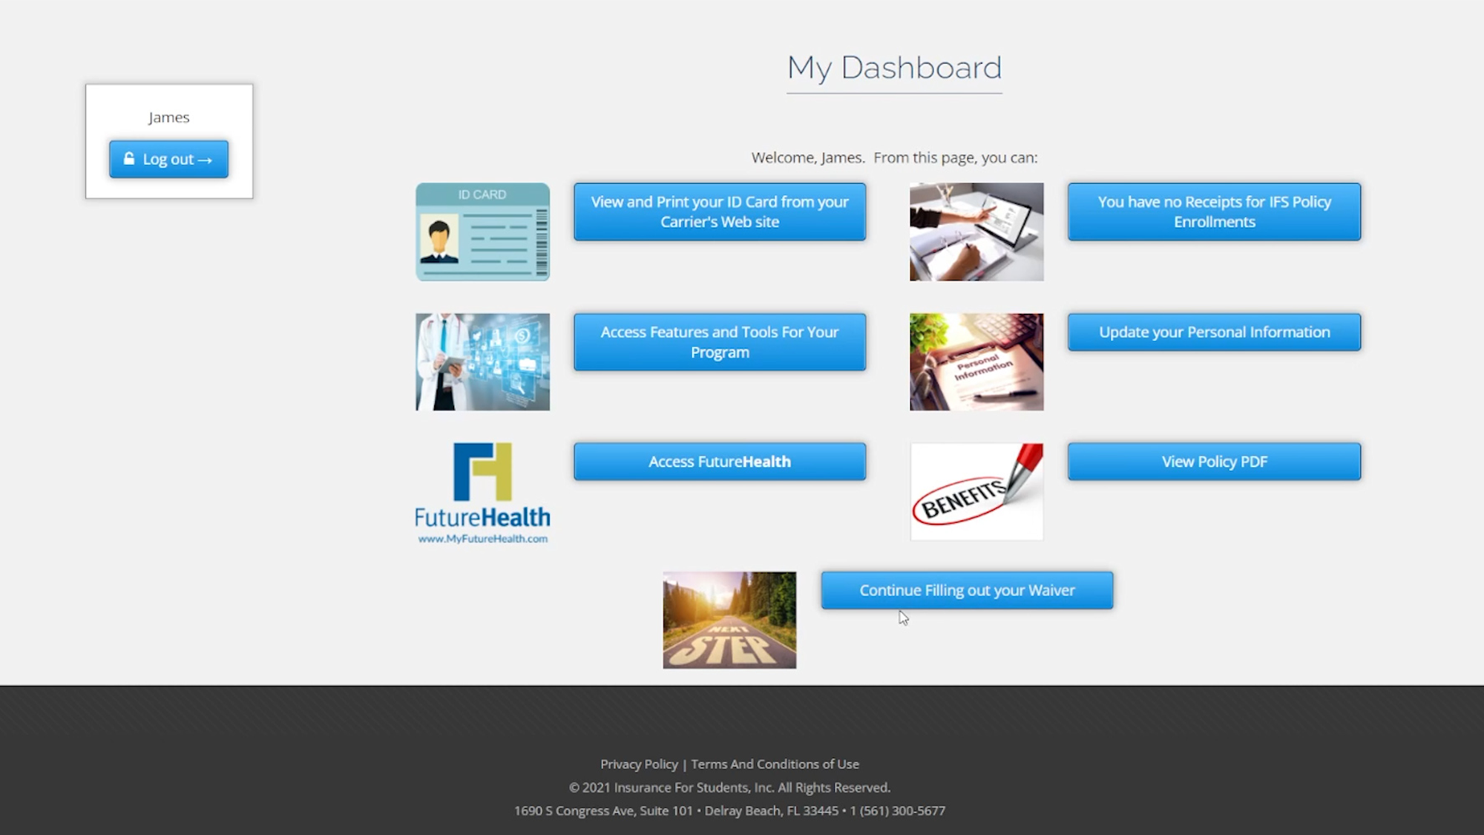
Students Waiver Status

Slide 17
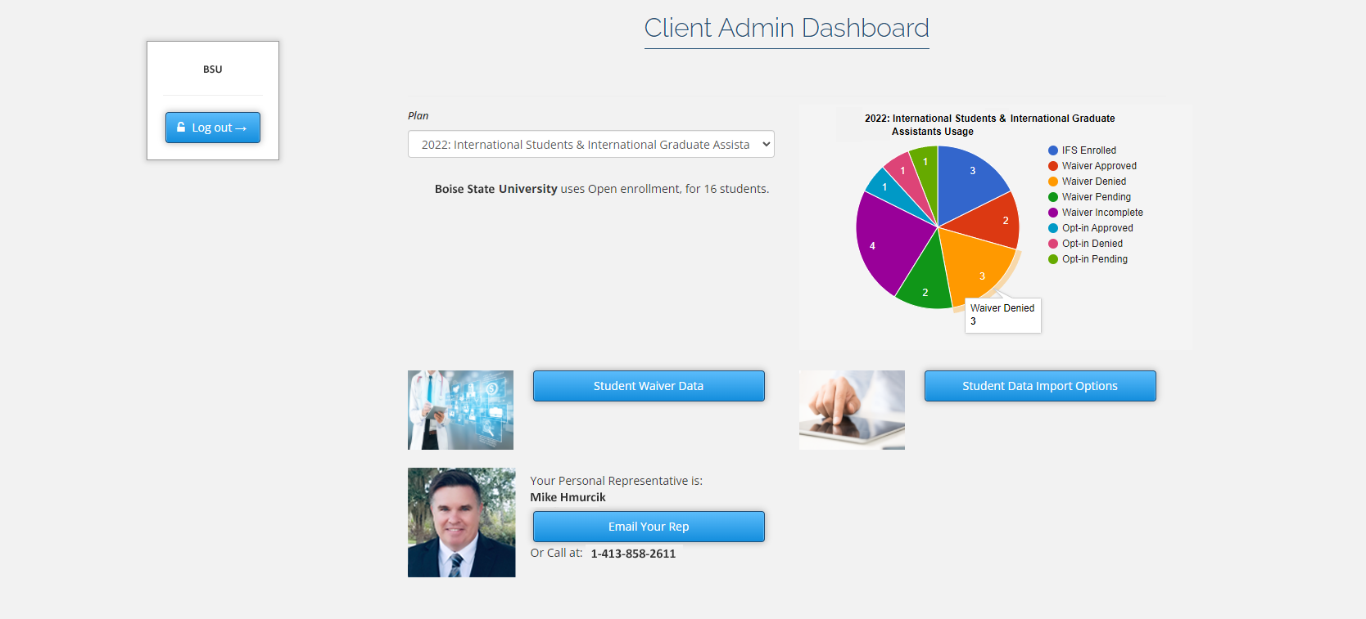
School Administrator Dashboard

Slide 18
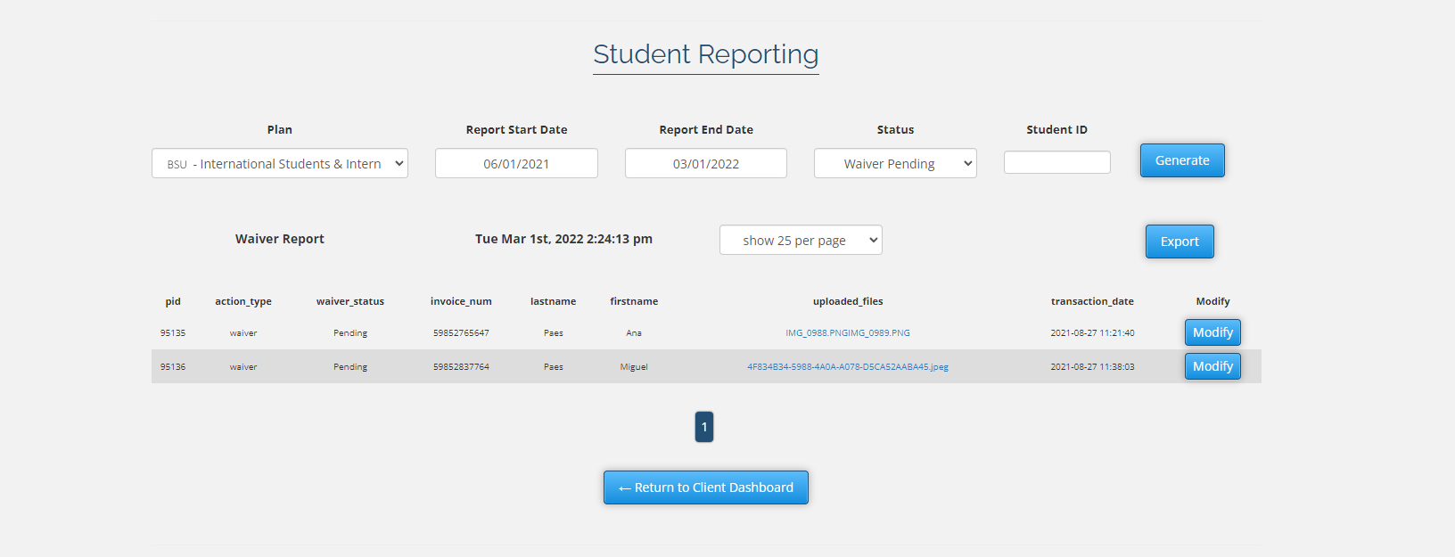
School Administrator Detailed Data

Slide 19

Waiver Customizability
Works with Open or Closed Lists
Total control of the waiver including when and how it can be accessed
Regular check-ins with your representative

Slide 20

Waivers that work for you
Online on-demand access to your waiver data
Completely customizable
Easy to use and manage

Slide 21
Enrollment Data
A secure SFTP file upload will be provided
An Excel enrollment list template will be provided
The IFS team will respond ASAP

Slide 22



Mental Health Services
Our Holistic Approach
A Student Assistance Program (ASAP) has three components:
FutureHealth’s online Health & Wellness program
3. 24/7/365 Counseling Hotline for support
2. Student Outreach

Slide 23


Health Education
FutureHealth’s Online Health & Wellness Education Program
This comprehensive education program includes topics such as:
Alcohol use disorder
Opioid use disorder
Sexual misconduct
Sleep deprivation
Anxiety and stress
Depression
Eating disorders
Diabetes
Personal safety
This program also offers the following enhancements:
Buddy chat forum
Additional Resources
Blogs and health events
Healthy recipes
Hiking trail locator
Health trivia
Program incentives
Assessments and goals
And more!

Slide 24


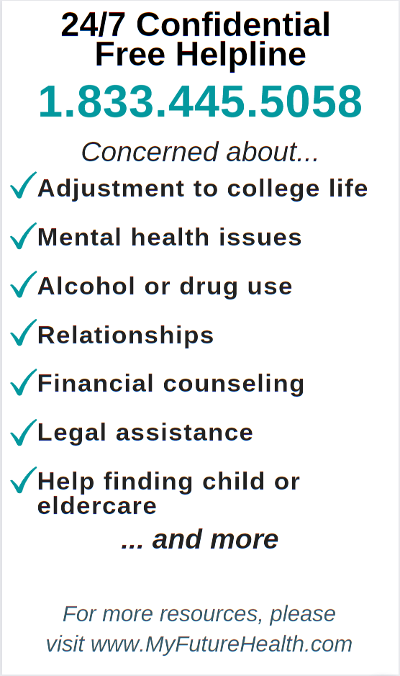


Student Outreach Program
Multi-faceted Communications
Inspirational texts
Daily emails
Health Promotion
Posters, brochures, cards, etc.
Encourages students to use campus resources and guides them to additional free resources
Customized Videos
For campus events
Virtual Events
Free webinars

Slide 25




Health Promotional Material
“Prioritizing Your Mental Health” cards
Exercise Poster
Depression Poster

Slide 26


Features of the Hotline
Immediate support 24/7 by phone 1-833-445-5058
Immediate translation service supporting 250+ languages
Cultural sensitivity in program delivery
Access to Masters level counselors
Ongoing telephonic and videoconference support
Carefully matched counseling referrals
Up to 3 face to face sessions with a professional counselor in the student’s insurance network for ongoing care
Consultation, resources and referrals for daily living needs such as community resources, financial counseling, legal services, and child and eldercare
Self-directed online resources including webinars, videos, courses, wellness tools and more
Live Wellness sessions delivered by videoconference on topics including mindfulness, breathing, meditation, chair yoga and journaling
Coastline maintains strict adherence to state and federal confidentiality laws

Slide 27
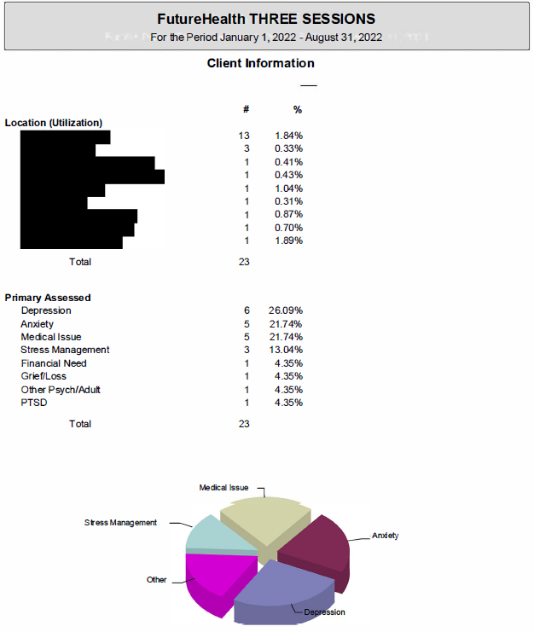

Slide 28
Marketing The Program
IFS’ Capabilities:
Physical & Online Marketing Material
Social Media
Email Blasts
Video Production
  Sample: Urgent Vs ER

Slide 29



Slide 30



Slide 31
Student Health Insurance
& Athletic Insurance Programs:
Next Steps
  Calendar of Events & Deliverables
Discovery
  Understanding Your Utilization
Cost Containment
Partnership
Addressing Mental Health & Wellness
  Virtual Events

Slide 32

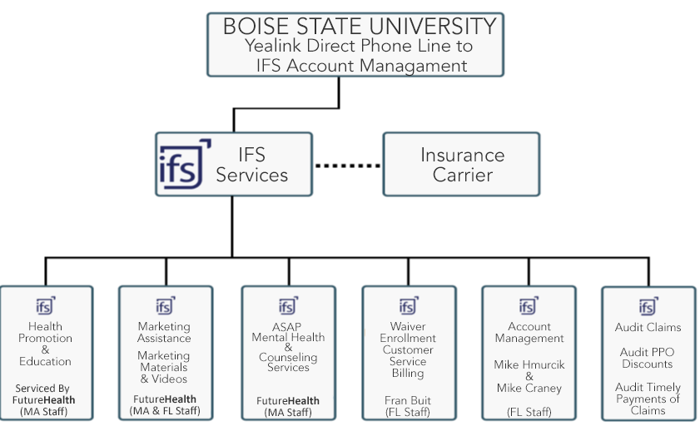
Yealink Video Phone
Program Structure

Slide 33
In Summary
Holistic Approach
Experience & Expertise

Slide 34

Question & Answers
A Partnership for Success

